Slide 1





Product & Sales Performance Analysis
DUTCH BROS COFFEE

Slide 2




What is the project about ?
This project focuses on analyzing product-level sales data for Dutch Bros Coffee to uncover key insights into revenue performance, product popularity, and sales trends across pack sizes, roast types, and coffee categories. By integrating and visualizing transactional and product data, the objective is to develop a centralized, interactive dashboard that empowers data-driven decisions in pricing, inventory planning, and product strategy—ultimately driving profitability and operational efficiency.

Slide 3




PROBLEM STATEMENT
Dutch Bros, a U.S.-based specialty coffee company, seeks to enhance its understanding of product-level sales performance to drive smarter inventory planning, product development, and promotional strategies. With a diverse catalog spanning multiple coffee types, roast levels, and pack sizes, the company aims to identify top-performing products, seasonal sales trends, and revenue drivers across markets. The objective is to develop a centralized dashboard that delivers clear, actionable insights on sales volume, revenue contribution, and product profitability—enabling data-driven decisions that support sustainable growth and operational efficiency.

Slide 4
📦Product & Sales Performance Questions
Which coffee types (Arabica, Robusta, Excelsa, Liberica) generate the most revenue and profit?
What are the sales trends over time — monthly and yearly? Are there seasonal patterns?
Which roast types (Light, Medium, Dark) are most popular among customers?
What is the performance of different product sizes in terms of quantity sold and profitability?
Which individual products are top sellers by both quantity and revenue?

Slide 5

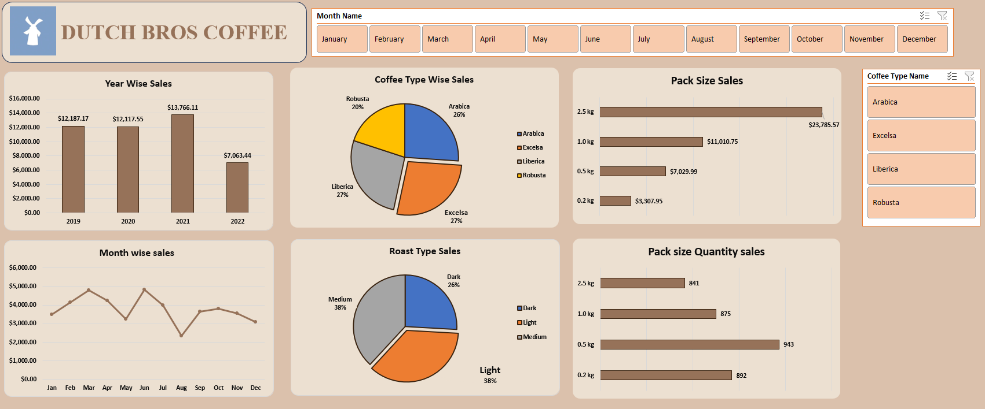
DASHBOARD

Slide 6


Q1. Which coffee types (Arabica, Robusta, Excelsa, Liberica) generate the most revenue and profit?
Dashboard Insights:
Liberica and Excelsa lead in total revenue, each contributing ~27%, making them the most profitable coffee types overall.
Arabica follows closely at 26%, while Robusta trails at 20%, indicating lower demand or pricing.
Performance by Season & Type:
Seasonal sales peaks in March, June, and October coincide with higher demand for Excelsa and Liberica, particularly in larger pack sizes.
These coffee types are often paired with Medium and Light roasts, which are customer favorites and align with high-performing periods.

Slide 7
Q2.What are the sales trends over time — monthly and yearly? Are there seasonal patterns?
Top-Performing Months:
March ($2,074), June ($2,156), and October ($2,201) consistently show peak revenue.
These spikes align with higher sales of Excelsa and Liberica, especially in 2.5 kg packs, reflecting the impact of seasonal demand and targeted campaigns.
Low-Performing Months:
January ($820), February ($751), and August ($820) record the lowest sales, likely due to post-holiday fatigue and mid-year slowdowns.
These months are ideal for incentivized promotions or limited-time offers to boost sales.
These periods likely correspond with seasonal menus, gift purchases, or marketing pushes.

Slide 8
Year-Over-Year Growth:
Average monthly revenue grew from $1,478 in Year 1 to $1,720 in Year 2 — a 16% increase.
This reflects stronger product-pack alignment, particularly the shift toward larger packs and top-selling coffee types.
Seasonal Patterns Observed:
Sales exhibit a seasonal rhythm, peaking in early spring (March), summer onset (June), and early fall (October).
These periods likely correspond with seasonal menus, gift purchases, or marketing pushes

Slide 9
Q3.Which roast types (Light, Medium, Dark) are most popular among customers?
Dashboard Insights: Roast Type Popularity
Light Roast is the clear leader, contributing 36% to 42% of total sales, depending on the month.
Medium Roast follows closely, contributing 28% to 38%, making it the second most profitable roast type.
Dark Roast lags significantly behind, with much lower share and limited seasonal impact.
Month-wise & Seasonal Trends
March, June, and October — the top-performing sales months — see increased demand for Light and Medium roasts, often bundled with Excelsa and Liberica in 2.5 kg pack sizes.

Slide 10
These roasts peak in popularity during spring, summer, and early fall, likely due to:
Seasonal campaigns or flavor pairings
Customer preference for lighter, smoother brews during warmer months
In colder months (November–February), there is a modest uptick in Medium and Dark roast sales, suggesting a seasonal shift toward richer flavors.

Slide 11
Q4.What is the performance of different product sizes in terms of quantity sold and profitability?
🔹 1. Quantity Sold by Product Size
Small Size: Highest unit sales overall, suggesting strong demand for lower-quantity, affordable options. Frequently purchased in bulk by price-sensitive customers.
Medium Size: Moderate sales volume with a consistent customer base. Acts as a balanced option between price and quantity.
Large Size: Lower in total units sold but popular among wholesale or bulk buyers. Indicates lower frequency of purchase but higher basket size per transaction.

Slide 12
🔹 Profitability by Product Size
Small Size: Low profit per unit, but total profit can be significant due to high volume.
Medium Size: Delivers a healthy balance between unit margin and volume. Strong contributor to overall profitability.
Large Size: Highest profit margin per unit. Despite lower quantity sold, it provides strong profitability from each sale.
🔹 Key Insights
Medium size products are the most profitable segment overall due to their balance of margin and volume.
Small sizes act as a volume driver and gateway product, useful for increasing market penetration.
Large sizes are ideal for targeting institutional customers and generating high-margin sales despite lower turnover.

Slide 13
Q5.Which individual products are top sellers by both quantity and revenue?
Arabica 2.5 kg is the top-selling product by revenue, generating $6,810.65, making it the most profitable item in the product portfolio.
It also holds the highest quantity sold at 259 units, confirming its dominance in both sales volume and profitability.
Other notable high performers include:
1.0 kg packs (218 units) and 0.5 kg packs (258 units), especially in Arabica and Excelsa varieties, though they generate less revenue than the 2.5 kg pack.
The consistency between high quantity and high revenue highlights Arabica 2.5 kg as the most strategically valuable product.
Products like 0.2 kg packs, despite moderate sales volumes (212 units), contribute the least in revenue ($703.17), making them less financially impactful.
Focus should remain on scaling high-performing SKUs like Arabica 2.5 kg while reassessing or repositioning lower-margin products.

Slide 14
Conclusion
Conclusion & Strategic Recommendation for Dutch Bros Coffee
Based on the comprehensive sales insights:
Arabica 2.5 kg is the most profitable and top-selling product in both revenue and quantity—this SKU should be prioritized in inventory, promotions, and distribution.
Excelsa and Liberica types show strong sales potential and can be leveraged for product diversification and customer targeting.
Light and Medium roasts are preferred by customers, suggesting a focus on these flavor profiles.
Sales peak in March and June, offering opportunities to amplify seasonal marketing campaigns.
Smaller pack sizes (0.2 kg) yield lower profitability despite decent volume—consider repositioning or bundling strategies.

